Slide 1

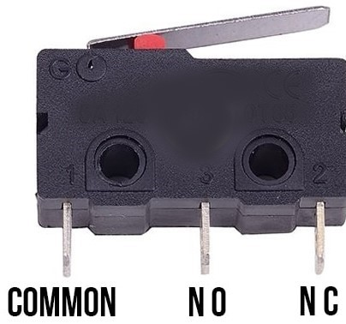
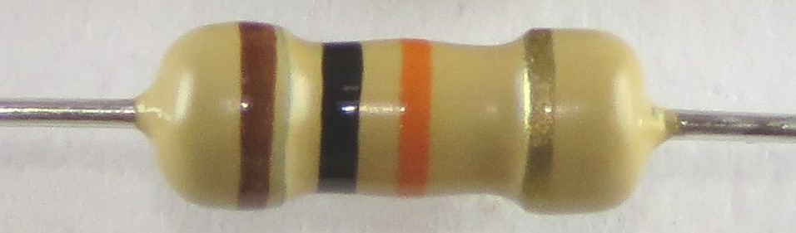
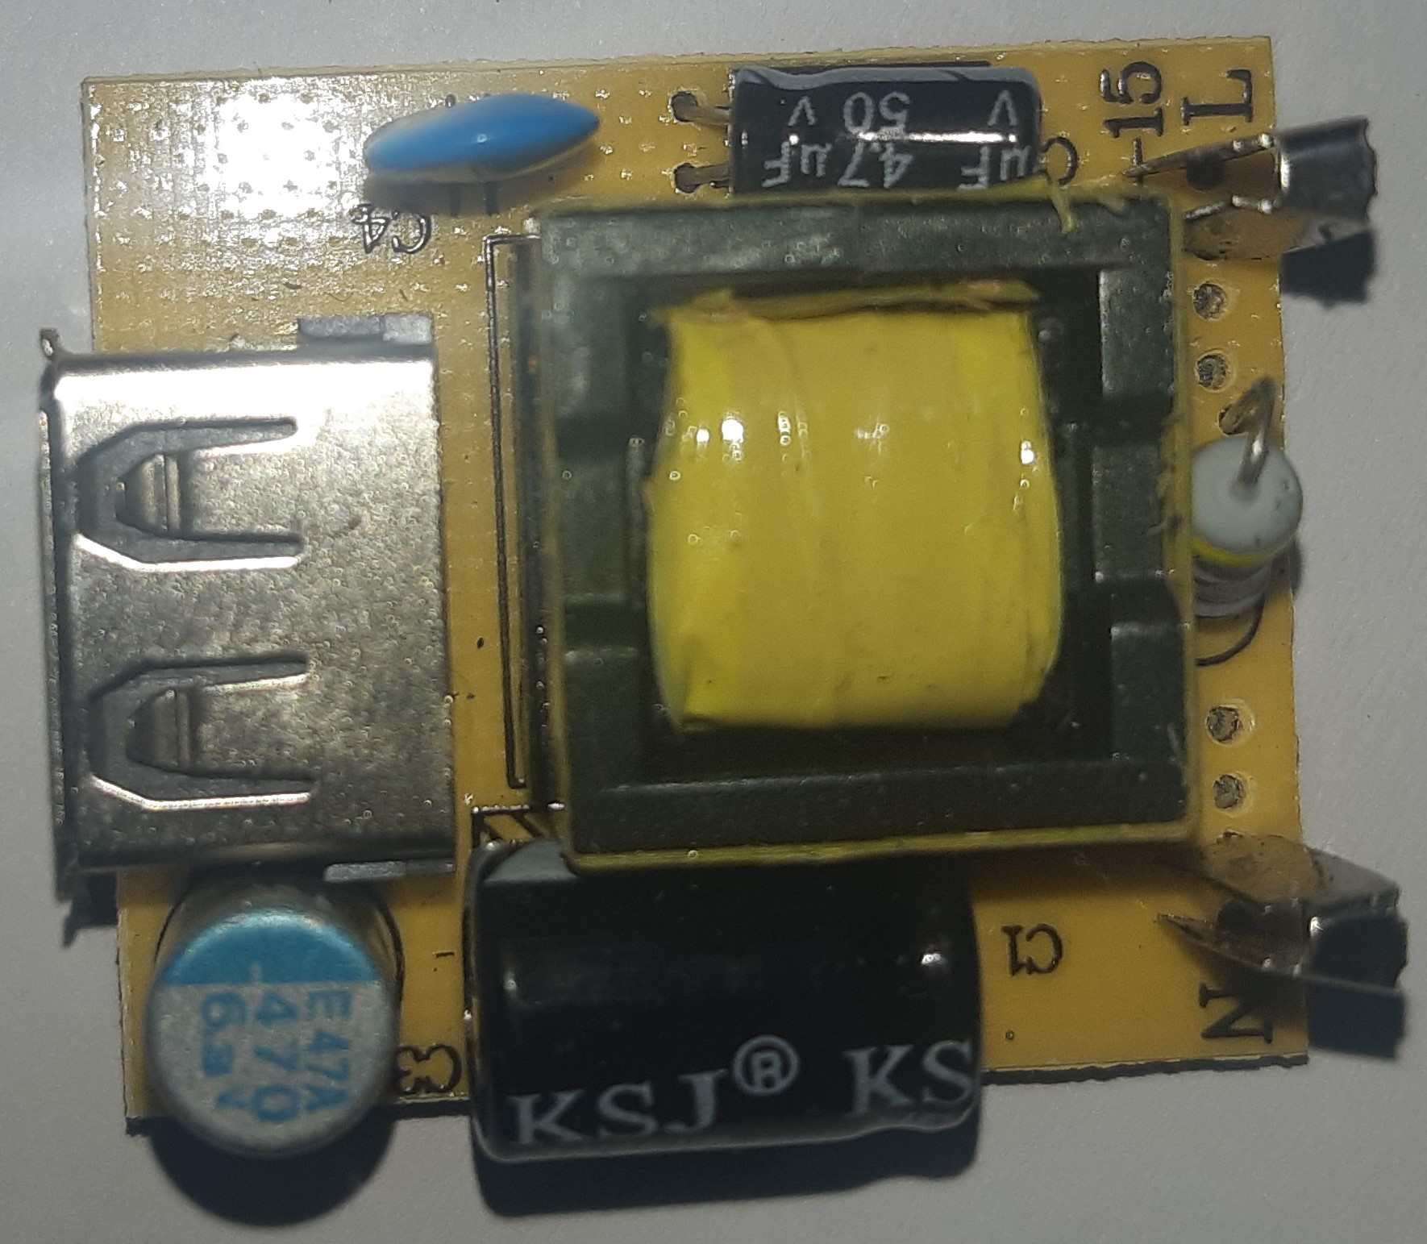
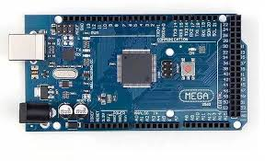
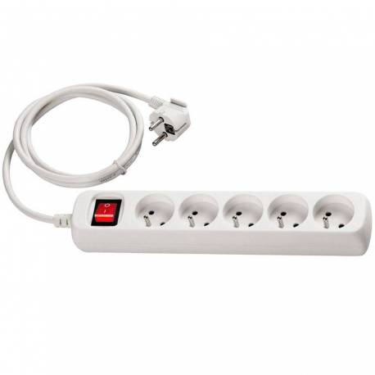
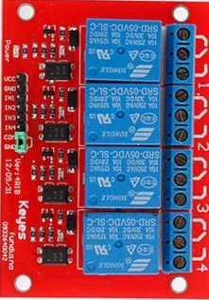
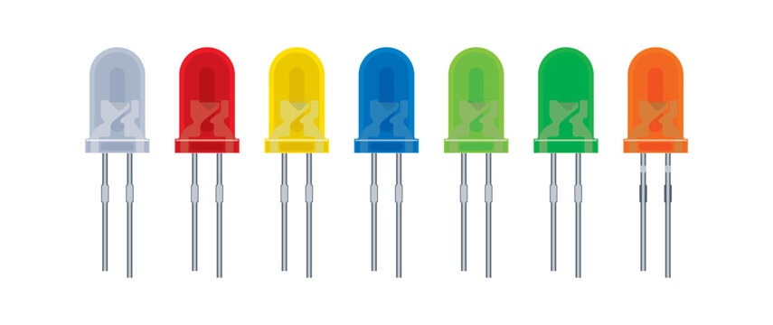
GND
Arduino SDA
VCC
SDA
Arduino SCL
SCL
Converter 110/230 to 5 volts
Power source 110/230 volts
Switch 1 on printer 1
I2C LCD 16x2
Switch 2 on printer 2
Switch 3 on printer 3
Pin 23
Pin 31
Pin 39
Pin 49
Pin 27
Pin 35
Pin 43
4-Channel Relay Shield
Sockets
Switch 4 on printer 4
Pin 53
Resistor 1M Ohms
printer 1
printer 2
printer 3
printer 4

